Slide 1
Management Actions Update
Board Audit Committee
Date: 11 December 2025

Slide 2
2024 PwC Management Letter Management Actions Update

Slide 3
Status of External Assurance Providers (PWC Management Letter) - 2024
# Findings
# Actions
1
2
3
4
5
6
7
PwC Management Letter – Follow-Up Summary
Management has been requested to provide the latest status updates on 7 open action items presented on the following slides.
Closed items will be subject to validation by Deloitte as part of their year-end audit procedures.
GIA continues to track progress and will report closure once external confirmation is received.

Slide 4
Details of Open PWC Management Letter Actions - 2024
S# | Finding Title | Management Action | Owner & Last Agreed Date | Status Update
1 | 1. Open risks not addressed in a timely manner [Open from FY22] | All high IRIS risks are being tracked and presented as part of MRC and BRC. The 9 risks related to Data Encryption and Masking are under remediation and being addressed as a special project. | Saket Saith Group Chief Technology & Data Officer 30-Nov-25 | 1.All High Risks are tracked by IT as part of our Risk and Audit meetings fortnightly with the GCTDO and action plans are available for all 12 pending High risks. 2.All High risks are presented in the MRC and BRC along with the overall trends of Medium and Low Risks. 3.A RAF extension was raised for all risks related to Data Encryption and Masking which has been approved by the GCTDO. It is pending approval of CRO for finalization. Update provided on 25-Nov-2025 It was submitted to the CRO for approval; however, further information was requested (a gap assessment that outlines the scale of non-compliance). A position paper was written and submitted on 18 November 2025. We are awaiting feedback. A follow up was sent on 25 November 2025. If all goes well, we envisage obtaining approval by mid-December or earlier.
2 | 2. ECL roles and responsibilities | In April 2025, there has been a shift in roles and responsibilities between the Risk Analytics and Finance teams in relation to the ECL calculations for retail and non-retail portfolios. | Farhan Mahmood Group Chief Risk Officer 31-Oct-25 | On track – Computations of the ECL provisions from the ECL engine for non-retail portfolio are now being performed by the Risk Analytics team. Update provided on 25-Nov-2025 Implemented - •Roles and responsibilities detailed in the credit provision policy, approved in MRC and BRC, •Since April, the ECL calculation is performed by Risk analytics for both retail and wholesale portfolios.

Slide 5
Details of Open PWC Management Letter Actions - 2024
S# | Finding Title | Management Action | Owner & Last Agreed Date | Status Update
3. | 3. ECL model recommendations | From a methodology perspective ECL is calculated based on discounted cash flows that it expects to receive at the EIR determined at initial recognition, or an approximation thereafter. Any changes/amendment will be reflected in existing documentation. | Farhan Mahmood Group Chief Risk Officer 31-Dec-25 | On track - Based on market practice and current assessment, the impact of using the contractual rate versus EIR appears to be low. We will perform a portfolio-level analysis to confirm if the difference is not material. We will also discuss the same with Deloitte to check their view at year end audit.
 |  | IFRS 9 methodology document will be updated by December 2025 (annual review date). |  | On track - As part of the periodic review exercise, the IFRS 9 methodology document will be updated to reflect changes / amendments that occurred since the last issuance.
 |  | ECL engine will run using the PiT PD model in the next financial year. |  | On track - This point is applicable to Retail, BBG, and WBG portfolios, where the bank currently holds ECL based on TTC PDs. We will perform the calculation using also PiT PDs for these portfolios.
4. | 4. Credit Risk Management Standards (CRMS) | IFRS 9 policy is prepared and will be approved by September 2025 | Jaffer Nini Group Chief Financial Officer 31-Dec-25 | Completed - The IFRS9 policy has been approved at MRC and BRC.
 | Stage 3 provisioning - Cash Flows discounting | All non-retail stage 3 customers are fully provided post accounting for collateral. In future, if there are any such instances than Management will conduct multiple probability-weighted expected cash flows in line with IFRS 9 and CBUAE requirements. This approach will be updated in current IFRS 9 methodology document by December 2025 (annual review date). | Farhan Mahmood Group Chief Risk Officer 31-Dec-25 | On track - The Bank will align to these requirements.

Slide 6
Details of Open PWC Management Letter Actions - 2024
S# | Finding Title | Management Action | Owner & Last Agreed Date | Status Update
5. | 5. Overall provisioning levels – Post Model Adjustments | The rationale and documentation for post model adjustments has been revisited in 2025 and same was tabled and approved in Q1’2025 Credit Provision Committee meeting. | Farhan Mahmood Group Chief Risk Officer 31-Dec-25 | On track – Additional rationale and analysis are provided to support the decision during CPC meetings
 | Overall provisioning levels – Month-end ECL reconciliation | Proper reconciliation between model output through GL is in place and same is included in monthly MIS and quarterly overlay memo tabled in credit provision committee meeting. | Jaffer Nini Group Chief Financial Officer 31-Dec-25 | Proper reconciliation between model output through GL is in place and same is included in monthly MIS and quarterly overlay memo tabled in credit provision committee meeting. No action pending from Finance.
6. | 6. Protego Insurance Brokers L.L.C. | Management will have the recon process automated by implementing the new system by end of 2026. | Shehzad Hameed Managing Director Retail Banking 31-Dec-26 | Core Broking System (Praktora) is under vendor assessment stage and shall be implemented early next year.
 |  | Manual reconciliation process is performed by CFU team which has been improvised by standardising the reconciliation templates. |  | As a tactical solution, CFU team have enhanced the manual reconciliation format and process to mitigate associated risks and improve the turnaround time (TAT).
7. | 7. Financial statement manual preparation | Management has process notes to manage inherent risk as a temporary measure while planning for a more permanent solution around automation of the financial statement preparation through implementation of ERP solution | Jaffer Nini Group Chief Financial Officer 31-Dec-25 | Management has process notes to manage inherent risk as a temporary measure while planning for a more permanent solution around automation of the financial statement preparation through implementation of ERP solution.

Slide 7

RAKBANK GROUP Open Management Actions Summary - Update

Slide 8
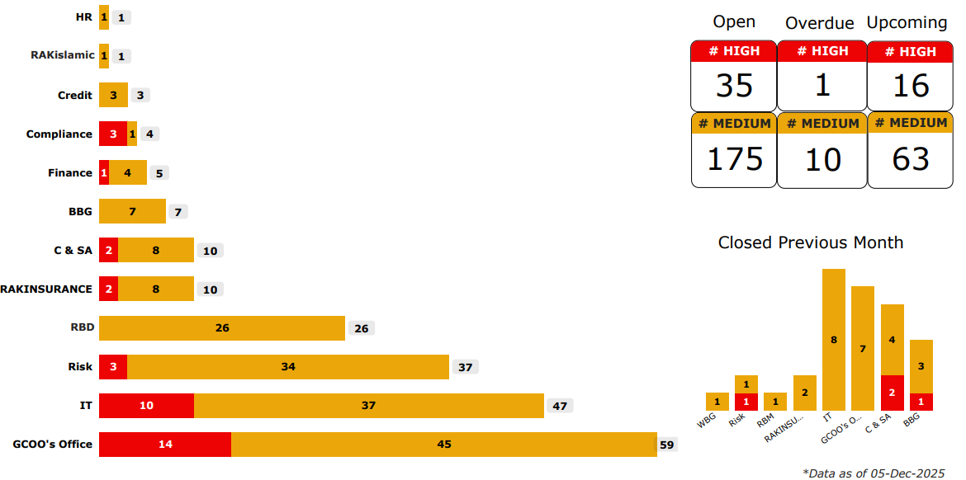
Open Management Actions Summary - GROUP
RBD
RAKINSURANCE
Note:
RAKINSURANCE - Management actions’ summary is shared from page 12-13 of this presentation.
RAKislamic - An update on the total open actions is provided under the Internal Shari’ah Audit Update section.

Slide 9
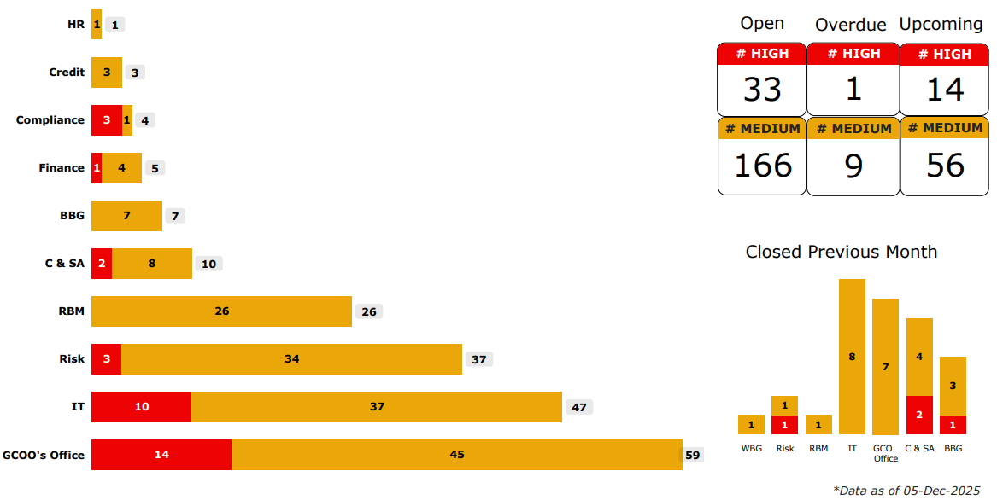
Open Management Actions Summary – RAKBANK (excluding RAKislamic & RAKINSURANCE)
RBD
RBD
Note:
The number of actions excludes those related to RAKislamic and RAKINSURANCE divisions, including actions from GIA audits

Slide 10
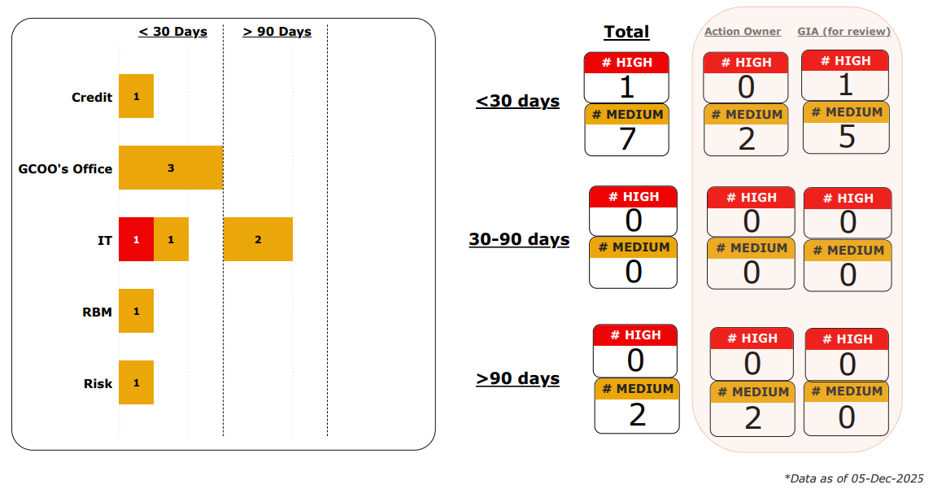
Overdue Management Actions Summary - RAKBANK (excl. RAKislamic & RAKINSURANCE)
*
RBD
Note:
The number of actions excludes those related to RAKislamic and RAKINSURANCE divisions, including actions from GIA audits

Slide 11
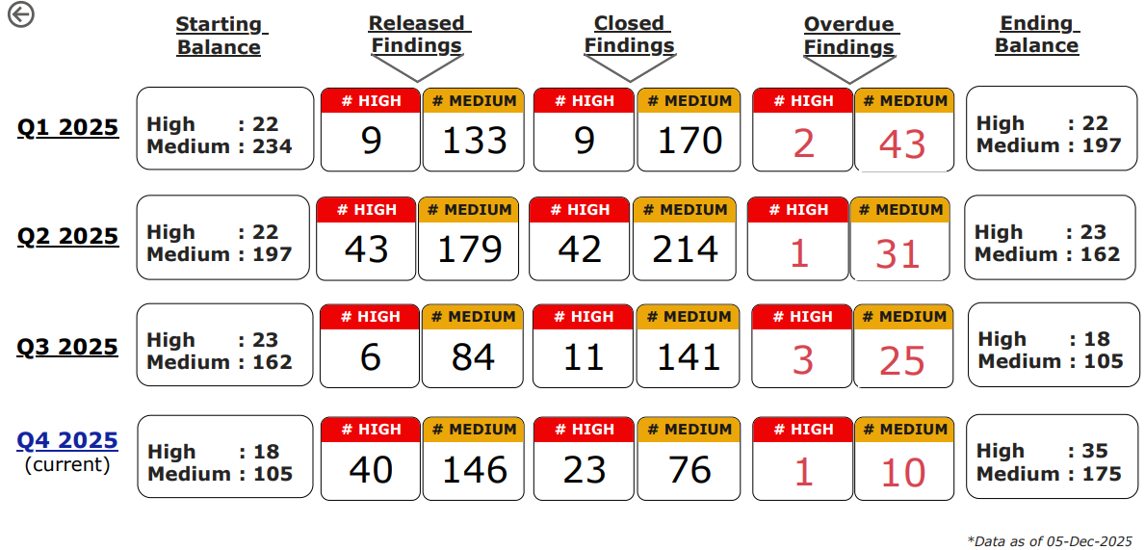
Open Management Actions Overview (Quarter-wise) - GROUP

Slide 12
RAKINSURANCE Open Management Actions Update

Slide 13
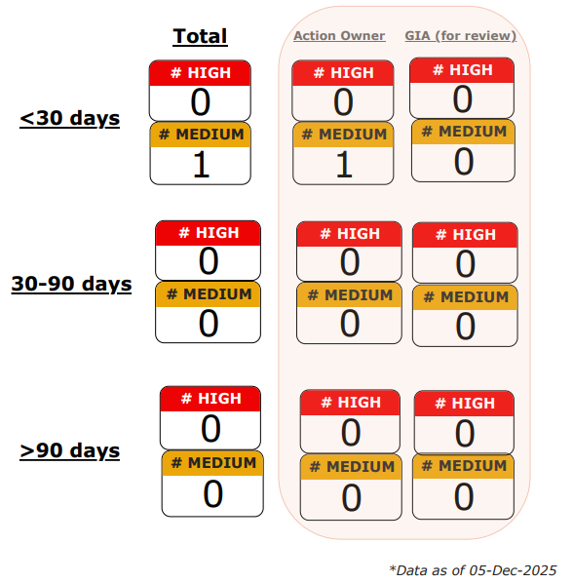
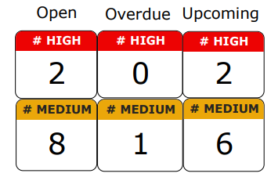
Open and Overdue Management Actions (RAKINSURANCE)
Actions Summary:
Overdue Actions:

